Slide 1
Naloxone in schools
Customize this cover slide with your school name, presentation date, school logo, etc., as desired.
Notes:
Notes:
This presentation is intended to help school nurses, staff, and others to advocate for a naloxone program in schools.
Customize this cover slide with your school name, presentation date, school logo, etc., as desired.
Brief, sample discussion points, and notes to presenters are included in this presentation (in notes) in select slides for reference, and may be customized, as needed. This presentation was developed in June 2023.
As some new data are released annually, please review/update slides accordingly to ensure the most up-to-date data/content are presented.

Slide 2
Contents
Scope of the Problem: The Drug Overdose Crisis
Opioids and Opioid Overdose
What is Naloxone?
Naloxone: Brands and Formulations
Naloxone: Considerations for Our Community
Additional Resources
Questions?
Notes:
Discussion Points:
School nurses are leaders in student health and have the education and expertise to assist our community and school leadership in assessing the need for and implementing a campus naloxone program to address drug overdoses in schools and/or in our community. Synthetic opioids like fentanyl have been contributing to increases in drug overdose deaths in the past decade, even among young people. Naloxone is an emergency medication school nurses can administer to save lives by quickly reversing drug overdoses caused by opioids.
In this presentation, we will discuss the drug overdose crisis, its effects on young people, and why it’s critical for [insert school/school district name] to have established policies and procedures for naloxone administration in case of potential drug overdose. We’ll also cover how synthetic opioids have contributed to increases in overdose deaths, as well as the life-saving opioid overdose reversal medication, naloxone.

Slide 3
Scope of the Problem: The Drug Overdose Crisis

Slide 4
The Drug Overdose Crisis
106,000+ people died from drug-involved overdose (including illicit drugs and prescription opioids).
National Drug-Involved Overdose Deaths*, Number Among All Ages, by Gender, 1999-2021
*Includes deaths with underlying causes of unintentional drug poisoning (X40–X44), suicide drug poisoning (X60–X64), homicide drug poisoning (X85), or drug poisoning of undetermined intent (Y10–Y14), as coded in the International Classification of Diseases, 10th Revision.
(Centers for Disease Control and Prevention [CDC], National Center for Health Statistics [NCHS], 2023)
Notes:
Discussion Points:
Drug overdose deaths have greatly increased among young people and other community members over the last decade.
This figure from the National Institute on Drug Abuse highlights the more than 106,000 drug-involved overdose deaths in 2021; these include illicit drugs and prescription opioids.

Slide 5
The Drug Overdose Crisis
National Drug-Involved Overdose Deaths*, Number Among All Ages, 1999-2021
*Includes deaths with underlying causes of unintentional drug poisoning (X40–X44), suicide drug poisoning (X60–X64), homicide drug poisoning (X85), or drug poisoning of undetermined intent (Y10–Y14), as coded in the International Classification of Diseases, 10th Revision.
(CDC/NCHS, 2023)
Notes:
Discussion Points:
Synthetic opioids, like illegally produced fentanyl, have been driving much of the surge in drug overdose deaths in the past several years. This second figure from the National Institute on Drug Abuse shows the continued increase of deaths from synthetic opioids other than methadone (involving primary fentanyl).
These synthetic opioids may be consumed (knowingly or unknowingly) by young people when mixed into or sold as other drugs like heroin, cocaine, or counterfeit pills. Because a lethal dose of fentanyl can be very small, using drugs contaminated with or replaced by fentanyl can increase the likelihood of an overdose.
We will talk more about synthetic opioids in the coming slides.

Slide 6
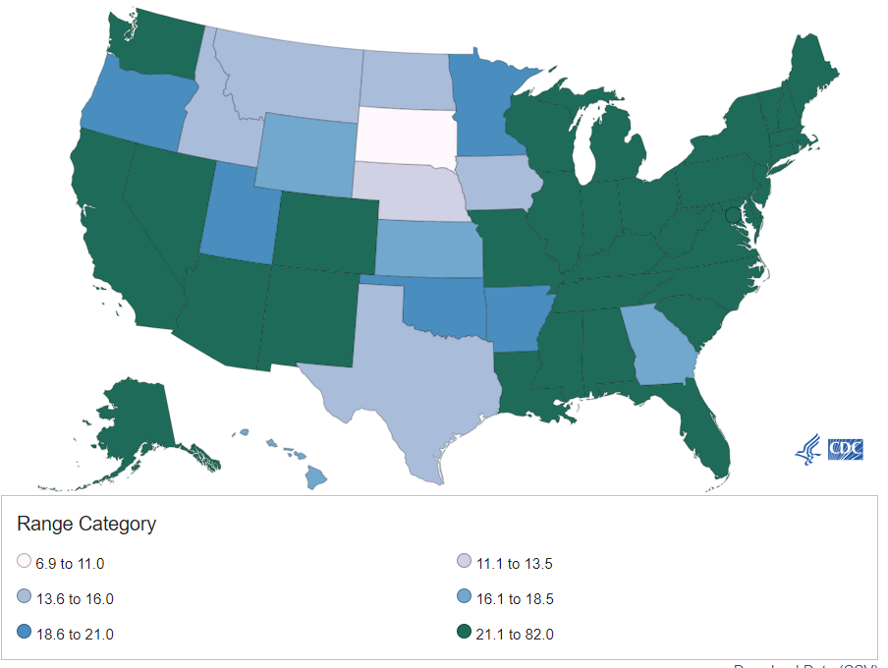
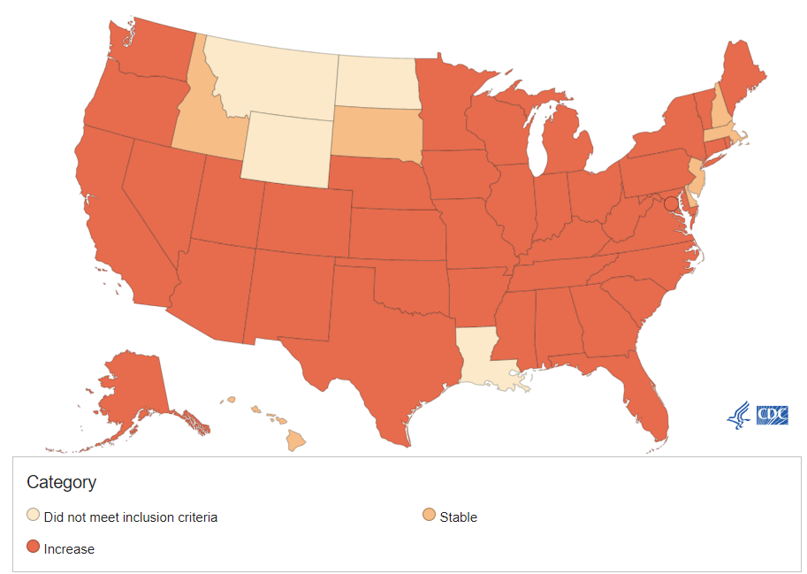
Changes in drug overdose death rates involving synthetic opioids by select states, United States, 2019 to 2020
Prevalence of Drug Overdose Deaths, Drug Overdose Deaths Involving Synthetic Opioids
Number and Age-adjusted Rates of Drug Overdose Deaths by State, US 2020
(CDC, 2021a; 2021b)
Notes:
Discussion Points:
The map on the left, with data from CDC, highlights the nearly nationwide increase in drug overdose death rates involving synthetic opioids from 2019 - 2020. The map on the right shows drug overdose death rates by state.
In our community [customize this discussion point by inserting statistics relevant to your community]
Notes:
If you are advocating for naloxone in your district, it is important to mention state and local community statistics on this slide to articulate the need for a naloxone program in your district.
You can find your state’s data on the CDC’s website (https://www.cdc.gov/drugoverdose/deaths/synthetic/index.html) under the prescription opioids and synthetic opioid overdose drop downs in the left-side navigation.
While talking with school leadership and staff, it is also important to note that school staff and visitors could also experience an overdose, expanding the potential need for having naloxone available from just students to other community members, as well.

Slide 7
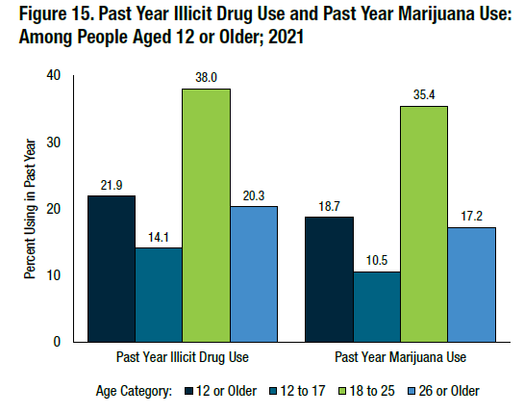
Drug Use Among Young People:
Facts & Statistics
3.7 Million Adolescents
(Miech et al., 2023; Substance Abuse and Mental Health Services Administration [SAMHSA], 2023)
Notes:
Discussion Points:
Drug use is a high-profile public health concern among young people, with 14.1% (or 3.7 million) of adolescents aged 12-17 years old reporting past-year illicit drug use in 2021.
Content and Graphic Source: https://www.samhsa.gov/data/sites/default/files/reports/rpt39443/2021NSDUHFFRRev010323.pdf - PDF page 16
**********************************************************
Additional statistics could be included on this slide:
In 2022, 11% of eighth graders, 21.5% of 10th graders, and 32.6% of 12th graders reported any past-year illicit drug use.

Slide 8

Adolescent Overdose Deaths are Increasing
Overdose deaths have increased among adolescents aged 10-19: (July – December 2019 to July – December 2021)
109% - median monthly overdose deaths
182% - deaths involving illicitly manufactured fentanyl (IMFs)
90% - deaths involving opioids
84% - deaths involving IMFs
25% - deaths where counterfeit pills were present
(Tanz et al., 2022)
Overdose can happen to anyone! Only 35% of the young people who died had a documented history of opioid use.
Notes:
Discussion Points:
This slide shows how much overdose deaths have increased among teens aged 10-19 years old.
A large takeaway from this slide is that overdose can happen to anyone! Only 35% of the young people who died had a known history of opioid use.

Slide 9
Opioids and Opioid Overdose

Slide 10
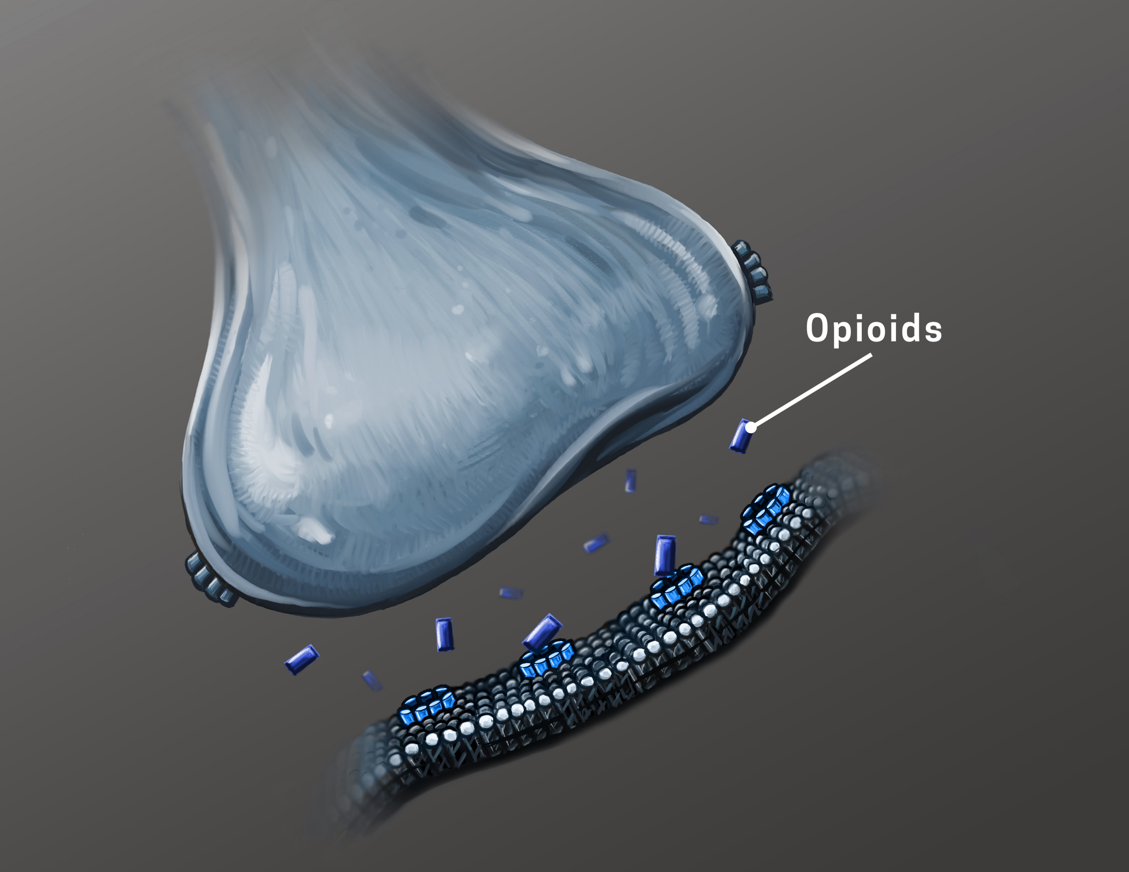
What are opioids?
Opioids bind to receptors in the brain that reduce the body’s perception of pain and create feelings of relaxation and pleasure.
Taking opioids regularly can lead to an opioid use disorder.
NIDA Flickr, https://flic.kr/p/2kcLpWE
Opioids include:
  Heroin
  Synthetic opioids like fentanyl
  Prescription pain medications like codeine, hydrocodone, hydromorphone, meperidine, morphine, oxycodone
(NIH/NIDA, 2020; 2021a; n.d.c)
Notes:
Discussion Points:
Opioids are medications that bind to specific receptors in the brain that reduce the transmission of pain signals throughout the body and create feelings of relaxation and happiness.
Taking opioids regularly can lead to an opioid use disorder.
Opioids are a class of drugs that include heroin, synthetic opioids like fentanyl, and other prescription pain relievers like oxycodone (OxyContin®), hydrocodone (Vicodin®), codeine, morphine, and many others.
Content Sources*:
NIDA, https://nida.nih.gov/research-topics/opioids
NIDA, https://nida.nih.gov/research-topics/commonly-used-drugs-charts#prescription-opioids
NIDA, https://nida.nih.gov/publications/drugfacts/prescription-opioids
Graphic Source: NIDA Flickr, https://flic.kr/p/2kcLpWE

Slide 11
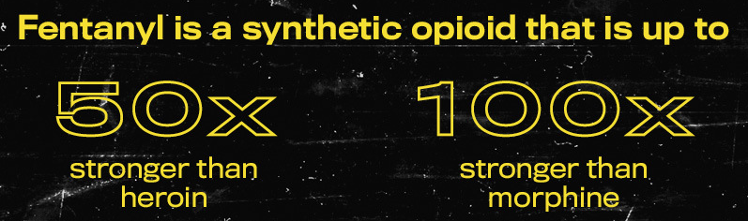
One of the most common drugs involved in drug overdose deaths in the United States.
Can be prescribed but is also made illegally.
Inexpensive to manufacture.
Can be mixed with other drugs (i.e., heroin, cocaine, meth, pressed pills); a person may not know that it’s been added, leading them to underestimate how much opioids they are taking and increase chance of overdose.
It is almost impossible to know whether a drug contains fentanyl.
  Test strips can help determine if fentanyl is present in a drug.
Naloxone can reverse a drug overdose from opioids, including fentanyl.
(CDC, 2022; 2023a; NIH/NIDA, 2021b)
Notes:
Discussion Points:
Fentanyl is a very powerful synthetic opioid
It is one of the most common drugs involved in drug overdose deaths in the United States
It can be prescribed but is also made illegally.
It is inexpensive to manufacture because its components are easy to get and are concentrated
It can also be mixed with other drugs (i.e., heroin, cocaine, meth, pressed pills); a person may not know that it’s been added, leading them to underestimate how much opioids they are taking and increase chance of overdose.
It is almost impossible to know whether a drug contains fentanyl without special equipment—like fentanyl test strips. Fentanyl is colorless, tasteless and odorless.
But remember, naloxone can stop a drug overdose from opioids, including fentanyl.
Image source: https://www.cdc.gov/stopoverdose/fentanyl/index.html

Slide 12

What Is an Opioid Overdose?
Someone is exposed to a dose of opioids too strong for their body to process
Slow breathing or no breathing
Hypoxia (not enough oxygen getting to the brain)
Psychological/neurological effects, coma, permanent brain damage, or death
(NIH/NIDA, 2021a)
Notes:
Image source: ambulance-stands-outside-modern-hospital-doctor-home-call-health-care-concept_189498-962.jpg (626×396) (freepik.com)

Slide 13
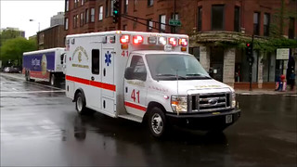
Naloxone Buys Time While EMS Are on Their Way
Average EMS response time is 7 minutes overall.
Average EMS response time in our community is [insert here] minutes.
Within 5 minutes without oxygen, brain damage starts to occur, soon followed by death.
This Photo by Unknown Author is licensed under CC BY
Life-saving naloxone can be administered by anyone before EMS arrives.
(Mell et al., 2017; CDC/NCHS, 2023)
Notes:
Discussion Points:
According to a 2017 JAMA study, “Emergency medical service units average 7 minutes from the time of a 911 call to arrival on scene. That median time increases to more than 14 minutes in rural settings, with nearly 1 of 10 encounters waiting almost a half hour for the arrival of EMS personnel.”
Life-saving naloxone can be administered by anyone before EMS arrives.
Notes:
To customize these slides, see the JAMA study, which presents average EMS response time data for suburban, urban, and rural areas, classified by zip code.
Image source: This is a PPT graphic

Slide 14
What is Naloxone?

Slide 15
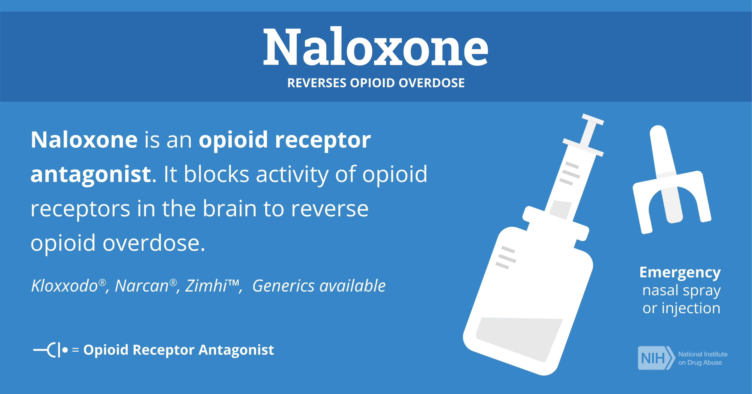
Naloxone is a medication that reverses opioid overdoses
NIDA Flickr - https://flic.kr/p/2ojTxco
Naloxone is extremely effective at reversing opioid overdoses.
Communities that combine naloxone distribution with opioid overdose education programs have significantly reduced overdose deaths.
(Enteen et al., 2010; NIH/NIDA, n.d.b.; SAMHSA, 2018; Walley et al., 2013)
Notes:
Discussion Points:
According to the National Institute on Drug Abuse, “Naloxone is a medicine that rapidly reverses an opioid overdose. It is an opioid antagonist. This means that it attaches to opioid receptors and reverses and blocks the effects of other opioids. Naloxone can quickly restore normal breathing to a person if their breathing has slowed or stopped because of an opioid overdose. But, naloxone has no effect on someone who does not have opioids in their system, and it is not a treatment for opioid use disorder. Examples of opioids include heroin, fentanyl, oxycodone (OxyContin®), hydrocodone (Vicodin®), codeine, and morphine.”
It’s important to note that more than one dose of naloxone may be needed to reverse the overdose. (SAMHSA)
Naloxone is extremely effective at reversing opioid overdoses. For example, a study of 399 overdose events that occurred in San Francisco between 2003 and 2009 found that 89% of overdoses were reversed following naloxone administration. (Enteen)
Communities that combine naloxone with opioid overdose education programs have significantly reduced overdose deaths. (Walley)
Image source:
NIDA Flickr - https://flic.kr/p/2ojTxco

Slide 16
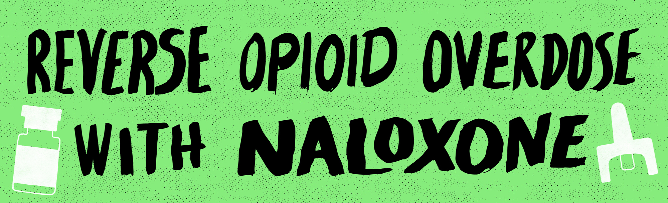
Naloxone Should Be Given as Soon as Possible
Naloxone should be administered IMMEDIATELY.
Naloxone is the first line treatment for opioid overdose.
  While naloxone does not reverse overdoses caused by tranquilizers (e.g., xylazine), stimulants, and other classes of drugs, naloxone should still be given if drug overdose is suspected in case opioids may be involved.
After administering naloxone, the responder (e.g., school nurse) should stay with the person until emergency help arrives.
(CDC, 2023b; NIH/NIDA, 2022; n.d.d; SAMHSA, 2018; Scott County Iowa, 2022; U.S. Food & Drug Administration, 2022)
Notes:
Discussion Points:
It should be administered IMMEDIATELY
Naloxone is the first line treatment for opioid overdose
Naloxone should always be given in suspected cases of overdose with tranquilizers, benzodiazepines, or stimulants because they are frequently combined with opioids; however, naloxone will only reverse the effects of opioid overdose.
It’s important to note that xylazine has been linked more and more to opioid overdose deaths as people are consuming it – knowingly or unknowingly—when it is added to illicit opioids. It is recommended to administer naloxone to reverse the effects of the opioid, though the effects from xylazine on breathing will not be reversed by naloxone.
After administering naloxone, the responder should stay with the person until emergency help arrives or for at least four hours to make sure their breathing returns to normal.
Image Source:
https://www.cdc.gov/stopoverdose/naloxone/index.html

Slide 17
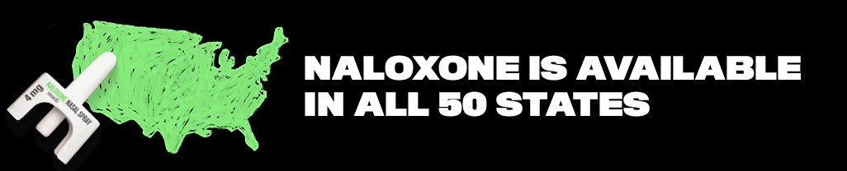
Naloxone is Safe to Use
Naloxone is a safe drug.
  If the person has not overdosed on an opioid, naloxone has no effect on the body!
  The risk of death from an opioid overdose is much greater than the risk of side effects from naloxone.
    There are virtually no adverse health effects from naloxone.
(CDC, 2023b)
Notes:
Discussion Points:
Parents & school administrators should not be concerned about adverse health effects of naloxone
The risk of death from an opioid overdose is much greater than the risk of side effects from naloxone.
There are virtually no adverse health effects from naloxone.
If the person has not overdosed on an opioid, naloxone has no effect on the body!
Image Source:
https://www.cdc.gov/stopoverdose/naloxone/index.html

Slide 18
Naloxone: Brands and Formulations
Notes:
Discussion Points:
According to the CDC, “There are two forms of naloxone that anyone can use without medical training or authorization: prefilled nasal spray and injectable. The decision on which form of naloxone to use or carry can depend many factors such as cost, availability, and comfort level. Both are safe, effective, and can help save a life.”
In the following slides, we’ll review several naloxone formulations and brands, their cost and shelf life, and other considerations for your district.
Review the FDA Orange Book under “naloxone” for additional options.
https://www.accessdata.fda.gov/scripts/cder/ob/index.cfm
Content source:
https://www.cdc.gov/stopoverdose/naloxone/index.html
Notes:
The following slides in this section are similar; use the slide(s) that align with the naloxone formulation(s) that you will be using in your district (e.g., generic naloxone, NARCAN, Kloxxado, etc.) and delete the unnecessary slides.

Slide 19
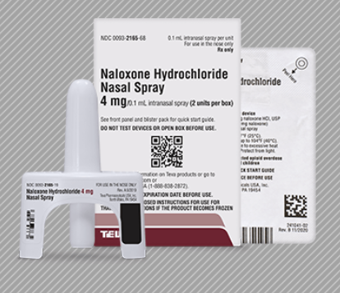
Generic Naloxone Nasal Spray
Type: Nasal spray
Cost: ADD
Shelf life: ADD
Cost to maintain and sustain the medication in the schools: ADD
Other financial sources identified to pay for the cost of the medication (i.e. community group, grant): ADD
© Company Name. Need a use w permission statement
Notes:
Notes:
Customize this slide by updating the highlighted text. Provide information on the cost of the medication, estimates on how much it will cost to maintain and sustain the medication in your district, and whether another financial source been identified to pay for the cost of the medication (i.e. community group, grant)
Image source: https://www.tevanaloxone.com/

Slide 20
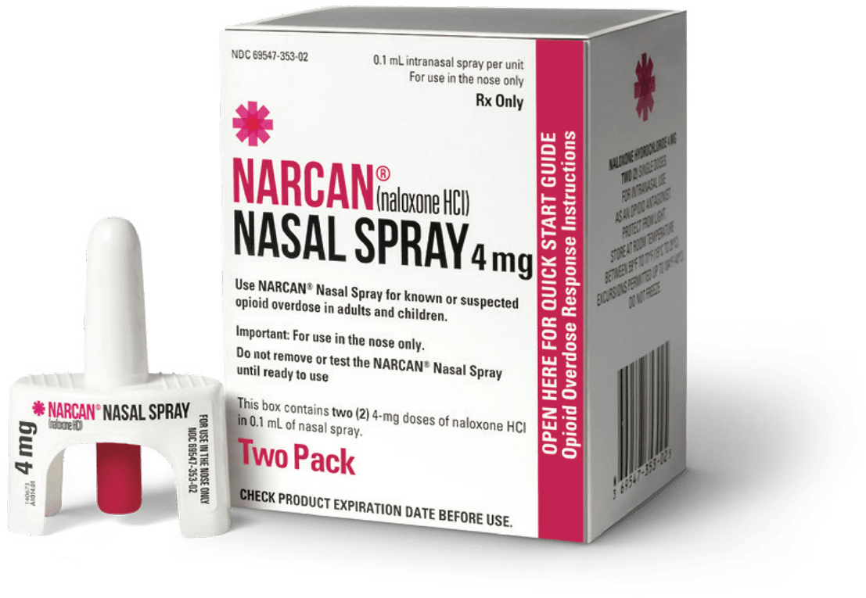
NARCAN Nasal Spray
Type: Nasal spray
Cost: ADD
Shelf life: 3 years for newly manufactured units; follow the expiration date on the package
Cost to maintain and sustain the medication in the schools: ADD
Other financial sources identified to pay for the cost of the medication (i.e. community group, grant): ADD
© Narcan, n.d. https://www.narcan.com/healthcare-professionals/pharmacists/#opioid-safety-checklist
Need a use w permission statement
Notes:
Notes:
Customize this slide by updating the highlighted text. Provide information on the cost of the medication, estimates on how much it will cost to maintain and sustain the medication in your district, and whether another financial source been identified to pay for the cost of the medication (i.e. community group, grant)
Content source: https://www.narcan.com/frequently-asked-questions/
Photo Source: https://www.narcan.com/healthcare-professionals/pharmacists/#opioid-safety-checklist

Slide 21
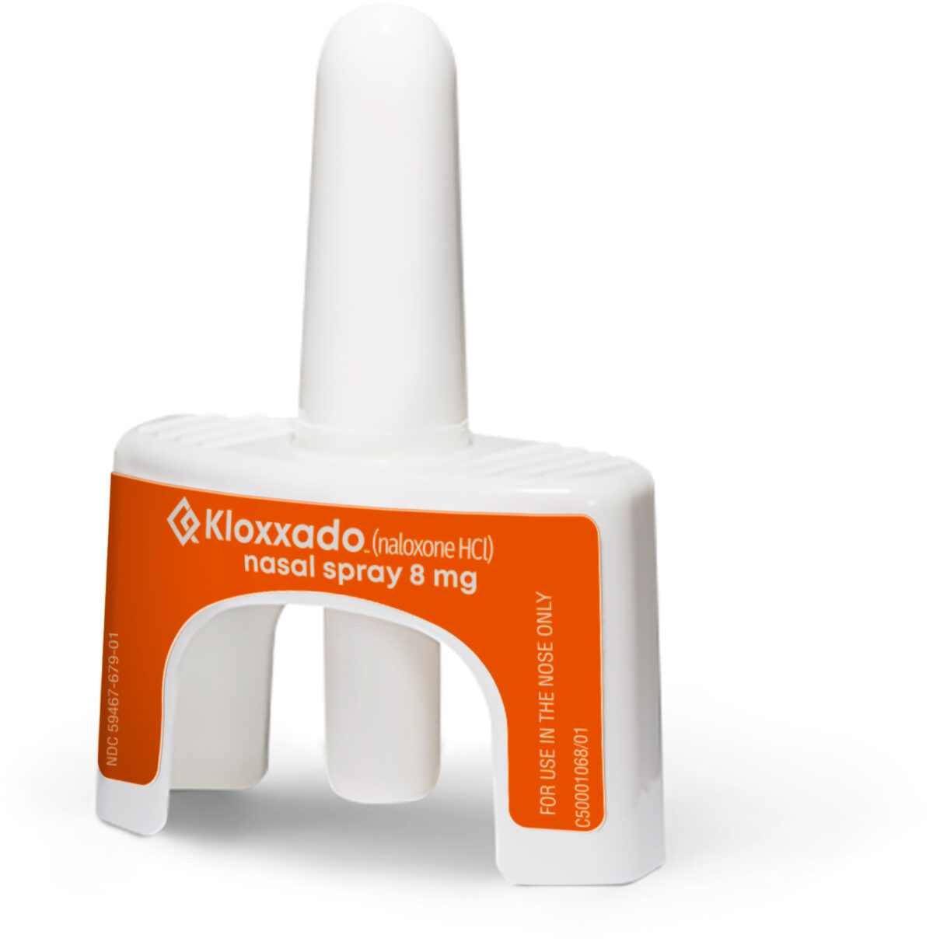
Kloxxado Nasal Spray
Type: Nasal spray
Cost: ADD
Shelf life: Follow the expiration date on the package
Cost to maintain and sustain the medication in the schools: ADD
Other financial sources identified to pay for the cost of the medication (i.e. community group, grant): ADD
© Kloxxado. https://kloxxado.com/what-is-kloxxado/ Used with permission
Notes:
Notes:
Customize this slide by updating the highlighted text. Provide information on the cost of the medication, estimates on how much it will cost to maintain and sustain the medication in your district, and whether another financial source been identified to pay for the cost of the medication (i.e. community group, grant)
Content source: https://kloxxado.com/faqs/
Photo source: https://kloxxado.com/what-is-kloxxado/

Slide 22
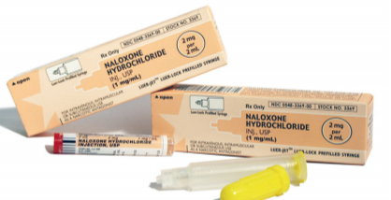
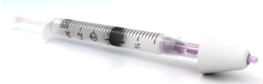
Generic Naloxone Injection
Type: Injection
Cost: ADD
Shelf life: ADD
Cost to maintain and sustain the medication in the schools: ADD
Other financial sources identified to pay for the cost of the medication (i.e. community group, grant): ADD
© Amphastar Pharmaceuticals, 2016 https://amphastar.com/assets/naloxone_9-182.pdf
Used with permission
Notes:
Notes:
Customize this slide by updating the highlighted text. Provide information on the cost of the medication, estimates on how much it will cost to maintain and sustain the medication in your district, and whether another financial source been identified to pay for the cost of the medication (i.e. community group, grant)
Image source: Amphastar Pharmaceuticals, 2016 - https://amphastar.com/assets/naloxone_9-182.pdf

Slide 23
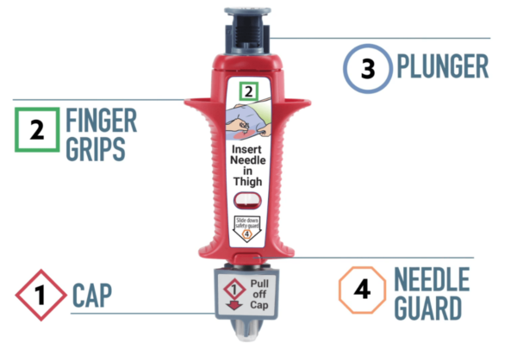
ZIMHI Injection
Type: Auto injection
Cost: ADD
Shelf life: Follow the expiration date on the package
Cost to maintain and sustain the medication in the schools: ADD
Other financial sources identified to pay for the cost of the medication (i.e. community group, grant): ADD
(College of Psychiatric and Neurologic Pharmacists, 2015)
©Zimhi, 2023 https://zimhi.com/patients-and-caregivers/how-to-use-zimhi/ Used with permission.
Notes:
Notes:
Customize this slide by updating the highlighted text. Provide information on the cost of the medication, estimates on how much it will cost to maintain and sustain the medication in your district, and whether another financial source been identified to pay for the cost of the medication (i.e. community group, grant)
Content source: https://zimhi.com/wp-content/uploads/2022/03/ZIMHI-Prescribing-Information.pdf
Photo source: https://zimhi.com/patients-and-caregivers/how-to-use-zimhi/

Slide 24
Naloxone: Considerations for Our Community

Slide 25
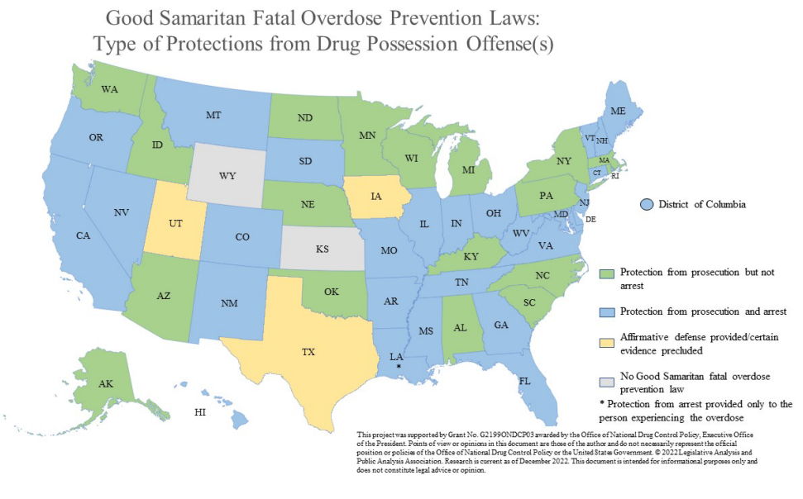
Good Samaritan Laws
Protects people from prosecution or arrest if they call 911 to save someone experiencing an overdose.
These laws may also protect the person who is experiencing an overdose.
(Legislative Analysis and Public Policy Association, 2022)
Notes:
To find relevant laws for each state, visit the Legislative Analysis and Public Policy Association’s Good Samaritan Fatal Overdose Prevention And Drug Induced Homicide: Summary Of State Laws report.
*Research is current as of December 2022.
Discussion Points:
How do state good Samaritan laws affect naloxone in schools programs?
As of December 2022, 47 states and the District of Columbia have Good Samaritan fatal overdose prevention laws. Only Kansas and Wyoming do not have such laws. Additionally, none of the other U.S. territories has a Good Samaritan fatal overdose prevention law in place.
States have implemented laws to make it easier for first responders and the general public to obtain naloxone (for example, making formulations available over the counter). Additionally, to encourage people to assist an individual who is or may be experiencing an overdose, most states also enacted laws which protect laypeople who administer naloxone, in good faith, in an emergency from civil and/or criminal liability. The Legislative Analysis and Public Policy Association (LAPPA) undertook an extensive research project to determine the current status of naloxone access laws throughout the United States, including the District of Columbia and all U.S. territories. As of August 2020, all 50 states and the District of Columbia have some form of a naloxone access law. The laws vary significantly by state.

Slide 26
Community Access to Naloxone
ADD information on whether EMS, police and fire fighters carry naloxone in your community.
ADD information on whether your school’s police officer carries naloxone.
Notes:
Notes:
To assist school districts in making decisions regarding whether to stock naloxone in schools, it is important to provide district leadership with information about whether community first responders carry naloxone and if they would be responding to an emergency in the school setting.
Customize this slide, as appropriate for your district.

Slide 27
Check your state and local policies
Customize this slide for your community. Information can include:
  Do district policies allow for a prescription medication to be given without parent permission?
  Are there state laws that allow or prohibit administration of naloxone in school?
Notes:
Notes:
Customize this slide, as appropriate for your district.
The school nurse and/or the school administration responsible for developing the naloxone policies and protocols should review other district policies to determine if there are any conflicts with developing a naloxone program. For instance, do district policies allow for a medication to be given without parent permission?

Slide 28
Support for Naloxone in Schools
There is support for a naloxone program in schools from:
  ADD information on who you have spoken with regarding stocking naloxone in schools and include those who have provided their support for this program. Is there support from state leadership? Parent groups? Healthcare providers?
  Can include NASN position statement.
(National Association of School Nurses [NASN], 2020)
Notes:
Notes:
Include information on who you have spoken with regarding keeping naloxone in schools and include those who have provided their support for this program. Is there support from state leadership? Parent groups? Healthcare providers?
Can include NASN position statement https://higherlogicdownload.s3.amazonaws.com/NASN/8575d1b7-94ad-45ab-808e-d45019cc5c08/UploadedImages/PDFs/Position%20Statements/June_2020_Naloxone_PS_adopted.pdf

Slide 29
Additional Resources
Visit the NASN Naloxone Toolkit landing page [hyperlink once finalized] for additional resources, including:
  Sample Policies and Policy Development Resources
  Sample Protocols and Protocol Development Resources
  Overdose, Naloxone, and Opioids Education
  Substance Use Treatment Resources
  Communication Resources
(NASN, 2023)

Slide 30
Questions?

Slide 31
Thank you!
PRESENTER NAME
CONTACT INFORMATION
Notes:
Add your name and contact information here and any other resources.

Slide 32
References
Adamis Pharmaceuticals Corp. (2022). How to use Zimhi image. https://zimhi.com/wp-content/uploads/2022/03/ZIMHI-Prescribing-Information.pdf
Amphastar Pharmaceuticals. (2016). Generic Naloxone injection image. - https://amphastar.com/assets/naloxone_9-182.pdf
Centers for Disease Control and Prevention. (2021a). Drug overdose - 2020 drug overdose death rates.
https://www.cdc.gov/drugoverdose/deaths/2020.html
Centers for Disease Control and Prevention. (2021b). Synthetic opioid overdose data. https://www.cdc.gov/drugoverdose/deaths/synthetic/index.html
Centers for Disease Control and Prevention. (2022) . Stop overdose – Fentanyl test strips: A harm reduction strategy.
https://www.cdc.gov/stopoverdose/fentanyl/fentanyl-test-strips.html
Centers for Disease Control and Prevention. (2023a). Stop overdose – Fentanyl facts. https://www.cdc.gov/stopoverdose/fentanyl/index.html
Centers for Disease Control and Prevention. (2023b). Stop overdose – Lifesaving naloxone. https://www.cdc.gov/stopoverdose/naloxone/index.html
Centers for Disease Control and Prevention (CDC), National Center for Health Statistics (NCHS). (2023). Multiple cause of deaths 1999-2021. WONDER Online
Database. https://wonder.cdc.gov/mcd.html
Emergent Devices Inc. (2022). NARCAN nasal spray image. https://www.narcan.com/healthcare-professionals/pharmacists/#opioid-safety-checklist
Enteen, L., Bauer, J., McLean, R., Wheeler, E., Huriaux, E., Kral, A.H., & Bamberger. (2010). Overdose prevention and naloxone prescription for opioid users in San
Francisco. Journal of Urban Health, 87(6), 931-941. doi:10.1007/s11524-010-9495-8
Hikma Pharmaceuticals USA Inc. (2023). Kloxxado nasal spray image. https://kloxxado.com/what-is-kloxxado/

Slide 33
References
Legislative Analysis and Public Policy Association. (2022). Good Samaritan fatal overdose prevention and drug induced homicide: Summary of state laws.
https://Legislativeanalysis.org/wp-content/uploads/2022/12/Good-Samaritan-Fatal-Overdose-Prevention-And-Drug-Induced-Homicide-Summary.pdf
Mell, H.K., Mumma, S.N., Hiestand, B., Carr, B.G., Holland, T., & Stopyra, J. (2017). Emergency medical services response times in rural, suburban, and urban areas.
JAMA Surgery, 152(10), 983-984. doi: 10.1001/jamasurg.2017.2230
Miech, R.S., Johnston, L.D., Patrick, M.E., O’Malley, P.M., Bachman, J.G., & Schulenberg, J.E. (2023). Monitoring the Future national survey results on drug use,
1975-2022: Secondary school students. Institute for Social Research, University of Michigan.
https://monitoringthefuture.org/results/publications/monographs/
National Association of School Nurses. (2020). Naloxone in the school setting (Position Statement). https://www.nasn.org/nasn-resources/professional-practice
-documents/position-statements/ps-naloxone
National Association of School Nurses. (2023). Naloxone Toolkit – WHEN DONE
National Institutes of Health, National Institute on Drug Abuse (NIDA). (n.d.a) NIDA NeuronIllustration Opiods image. https://www.flickr.com/photos/nida-nih/
National Institutes of Health, National Institute on Drug Abuse (NIDA). (n.d.b) Naloxone reverses opioid overdose image. https://www.flickr.com/photos/nida-nih/
National Institutes of Health, National Institute on Drug Abuse (NIDA). (n.d.c) Opioids. Research Topics. https://nida.nih.gov/research-topics/opioids
National Institutes of Health, National Institute on Drug Abuse (NIDA). (n.d.d ). Xylazine. Research Topics. https://nida.nih.gov/research-topics/xylazine
National Institute of Health, National Institute on Drug Abuse (NIDA). (2020 ). Commonly used drugs charts. Research Topics. https://nida.nih.gov/research- topics/commonly-used-drugs-charts#prescription-opioids
National Institutes of Health, National Institute on Drug Abuse (NIDA). (2021a). Prescription opioids DrugFacts. Publications.
https://nida.nih.gov/publications/drugfacts/prescription-opioids
National Institutes of Health, National Institute on Drug Abuse (NIDA). (2021b). Fentanyl DrugFacts. Publications. https://nida.nih.gov/publications/drugfacts/fentanyl

Slide 34
References
National Institutes of Health, National Institute on Drug Abuse (NIDA). (2022). Naloxone DrugFacts. Publications.
https://nida.nih.gov/publications/drugfacts/naloxone
National Institutes of Health, National Institute of Neurological Disorders and Stroke (NINDS). (2023 n.d.) Cerebral hypoxia. Health Information.
https://www.ninds.nih.gov/health- information/disorders/cerebral-hypoxia
Scott County Iowa. (2022). Reverse opioid overdose with Naloxone image. https://www.scottcountyiowa.gov/health/post/iowa-expands-naloxone-initiative-0
Substance Abuse and Mental Health Services Administration (SAMHSA). (2018). Opioid overdose prevention toolkit. Evidence-Based Resource Center. https://www.samhsa.gov/resource/ebp/opioid-overdose-prevention-toolkit
Substance Abuse and Mental Health Services Administration (SAMHSA). (2023) Data source – 2021 national survey of drug use and health (NSDUH) releases. Data. https://www.samhsa.gov/data/release/2021-national-survey-drug-use-and-health-nsduh-releases
Tanz, L.J., Dinwiddie, A.T., Mattson, C.L., O’Donnell, J., & Davis, N.L. (2022). Drug overdose deaths among persons aged 10–19 years — United States, July 2019-
December 2021. Morbidity and Mortality Weekly Report, 71(50), 1576–1582. doi: http://dx.doi.org/10.15585/mmwr.mm7150a2.
U.S. Food & Drug Administration (FDA). (2022, November 8). FDA alerts health care professionals of risks to patients exposed to xylazine in illicit drugs. Drug Safety and Availability. https://www.fda.gov/drugs/drug-safety-and-availability/fda-alerts-health-care-professionals-risks-patients-exposed-xylazine- illicit-drugs
Walley, A.Y., Xuan, Z., Hackman, H.H., Quinn, E., Doe-Simkins, M., Sorensen-Alawad, A., Ruiz, S., & Ozonoff, A. (2013). Opioid overdose rates and implementation
of overdose education and nasal naloxone distribution in Massachusetts: Interrupted time series analysis. BMJ, 346:f174. doi: 10.1136/bmj.f174
Zimhi. (2023). How to use Zimhi image. https://zimhi.com/patients-and-caregivers/how-to-use-zimhi/

